Slide 1
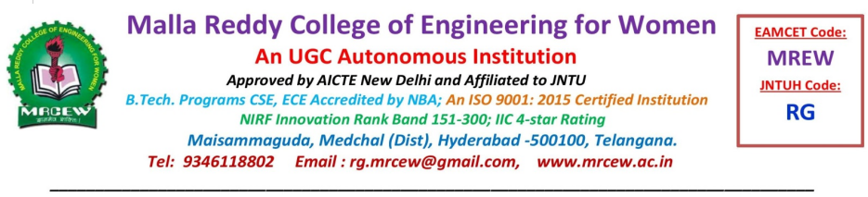
Department of electronics and communication engineering
Subject:- Advanced English communication skills laboratory
Seminar topic:- MEDARAM JATHARA
Presented by:-
Name:- T.Simmi
Roll no :- 22RG1A04B4
Year:-3-1
Branch:- ECE -B
Faculty name:- Mrs.D. Nirmala devi
Assistant professor

Slide 2
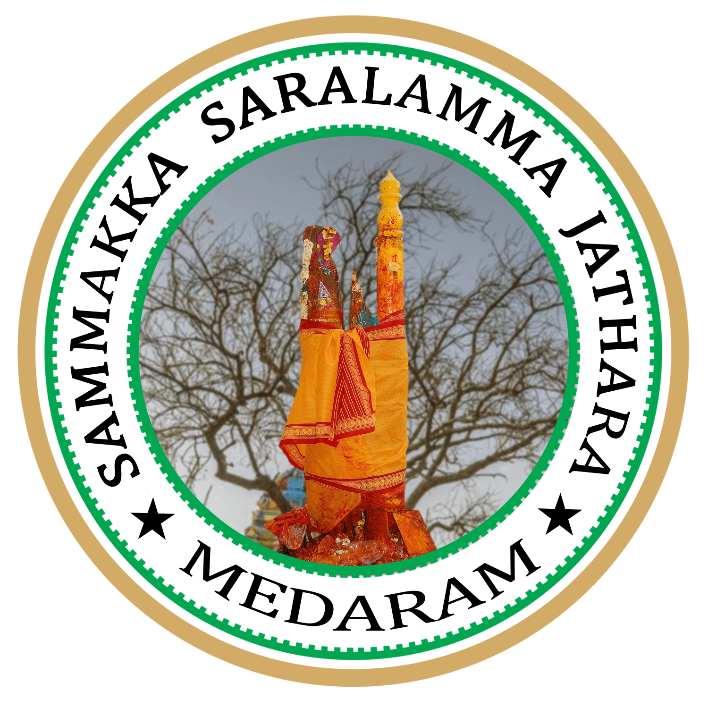
Introduction to Medaram Jathara
Sammakka Saralamma Jathara or Medaram Jathara is a tribal festival of honouring the goddesses celebrated in the state of Telangana, India.
The Jathara begins at Medaram in Tadvai Mandal in Mulugu district.
held every two years (biennually), with approximately ten million people converging on the place, over a period of four days, which is 90km from Warangal city.
Many tribal Devotees from different states of India (M.P, Chhattisgarh, Orissa, Maharashtra, Karnataka and parts of Jharkhand)reach to the festive place to celebrate the Jathara.

Slide 3
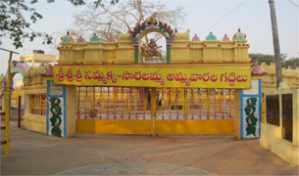
Historical Significance
There are many legends about the miraculous powers of sammakka. According to a tribal story, about 6-7 centuries ago, that is in the 13th century, some tribal leaders who went for a hunting found a new born girl (Sammakka) emitting enormous light playing amidst tigers.
She was taken to their habitation . The head of the tribe adopted her and brought up as a chief tain (She later became the saviour of the tribals of the region) she was married to Pagididda Raju a feudatory tribal chief of Kakatiyas(who ruled the country of Andhra from Warangal City between 1000 AD and 1380 AD).
She was blessed with 2 daughters and one son namely Sarakka, Nagulamma and Jampanna respectively.

Slide 4
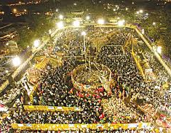
Cultural Practices
The festival features various rituals, including the traditional offerings of jaggery, rice, and flowers to the deities.
Day 1:-Goddess Saralamma Ammavaru will arrive on Gadde from Kannepally village
Day 2:-Goddess Sammakka Ammavaru will arrive on Gadde from Chilakala Gutta.
Day 3:-Jathara will be in its full swing. Crores of pilgrims will have darshan of these “DEVATHAS’and will offer their “MOKKUBADULU”.
Day 4:-Afternoon Ammavarlu Vana Pravesham.

Slide 5
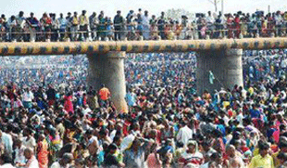
Jampanna vagu
According to the history, Jampanna is the tribal warrior and the son of Tribal Goddess Sammakka. The Jampanna vagu took his name as he died in a battle fighting against Kakatiyan Army in that stream .The Jampanna vagu is still red in colour marked with the blood of Jampanna
Tribal's believe that taking a holy dip in the red water of Jampanna Vagu reminds them the sacrifice of their gods who save them and also induces courage into their souls. There is a bridge constructed on top of Jampanna Vagu, known as Jampanna Vagu bridge.

Slide 6
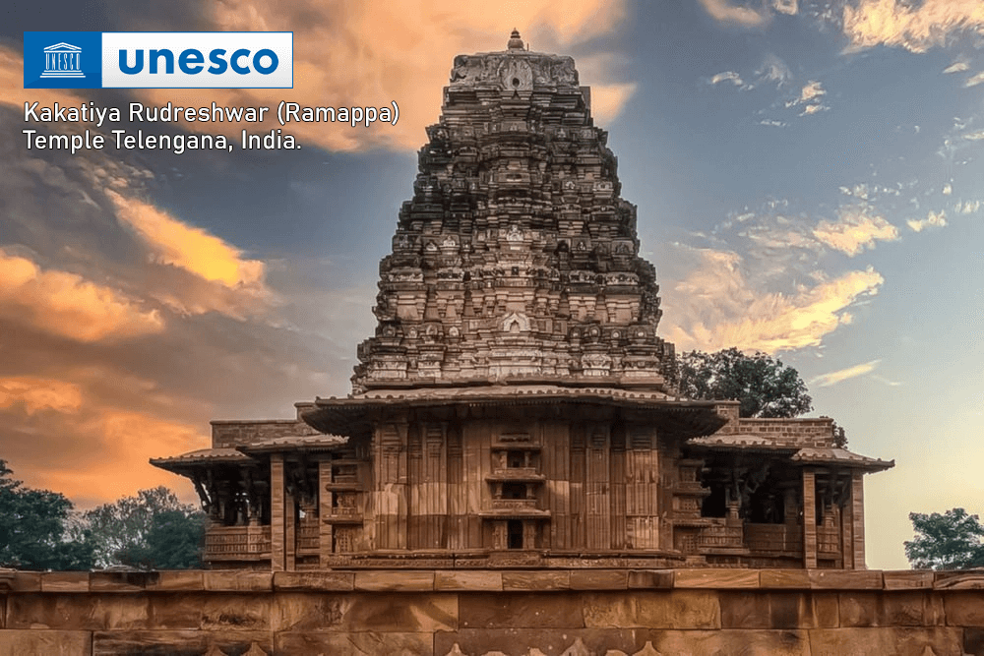
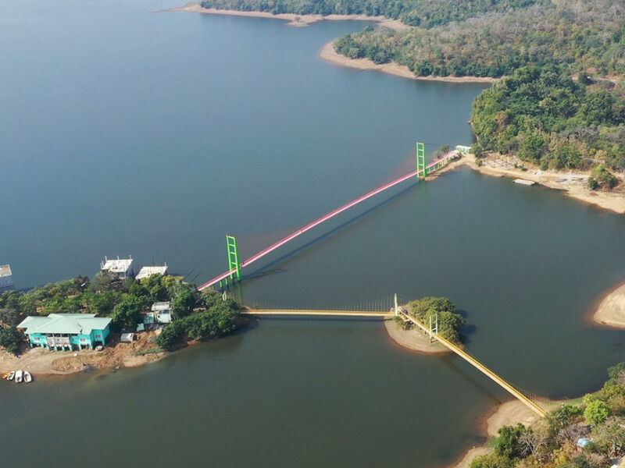
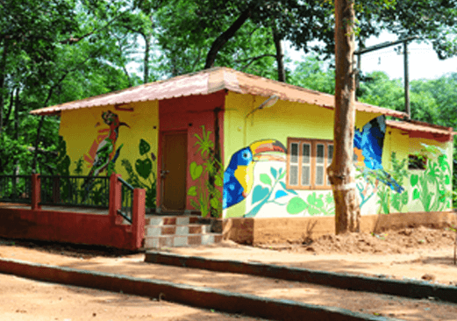
Near by Attractions:-
3.Tadvai Forest Huts & Cycling
Rammappa temple
2.Laknavaram Lake

Slide 7
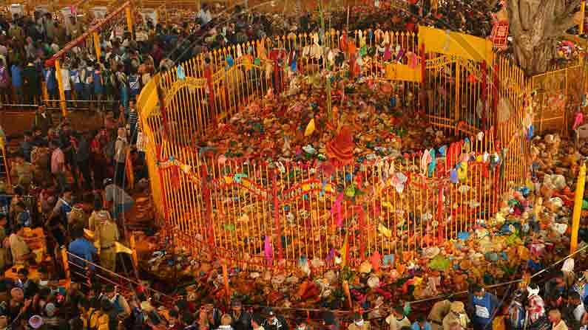
Conclusion and Future of Medaram Jathara
Medaram Jathara not only serves as a religious gathering but also promotes cultural identity and heritage among tribal communities.
Efforts are being made to preserve the traditions associated with the festival while also adapting to modern advancements.
As the festival continues to grow in popularity, it plays a vital role in promoting tourism and economic development in the region.

Slide 8


